Slide 1



Using Azure EventGrid w/ Fabric Notebooks
Notes:
Hello and welcome to this session on Azure Event Grid and Fabric Notebooks
I am really happy to have been selected to speak at this event again, as I have done a couple of times before. This time around it not going to be Power BI specific, rather a mix of something new and something well established.

Slide 2




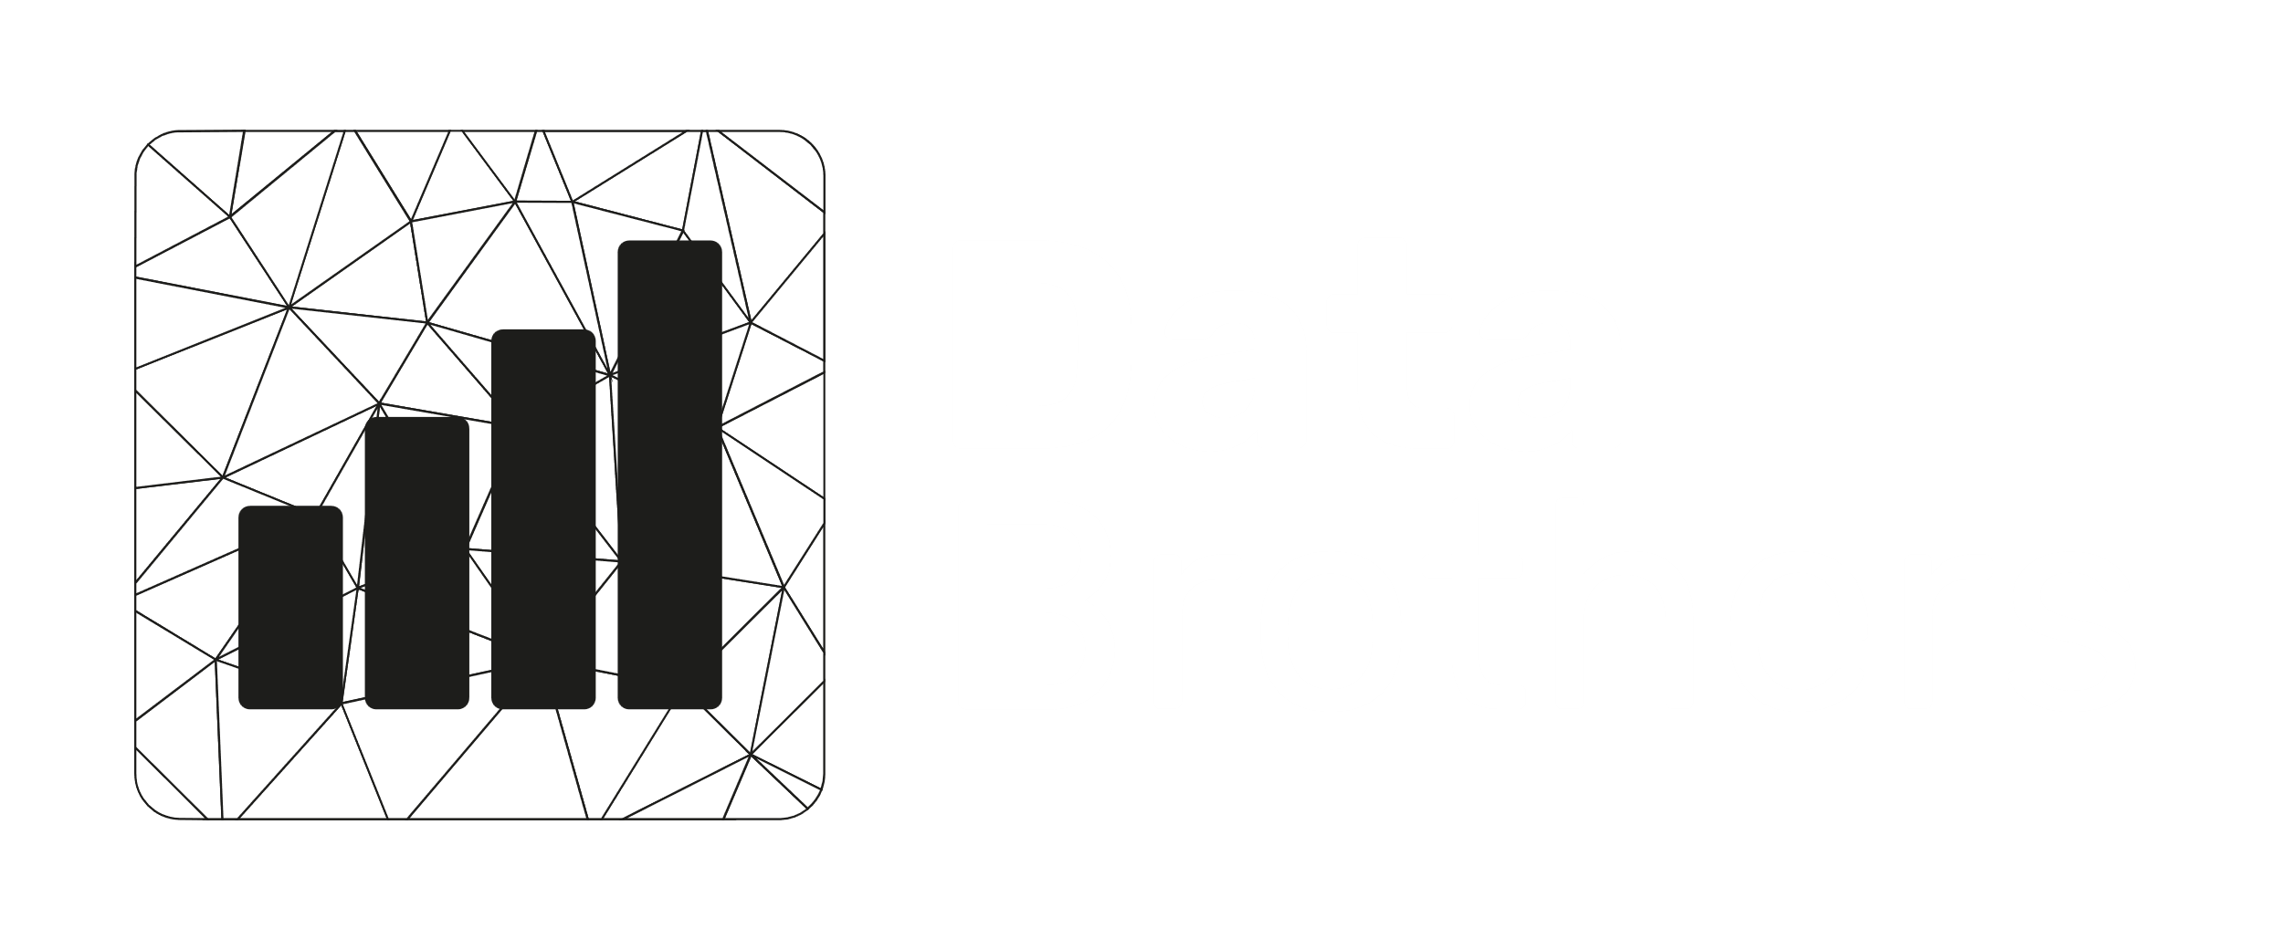



Partners
Data Point Prague 2024

Slide 3
Next 45 minutes
WHY – WHAT - HOW Caveat: Microsoft has not yet released a full FABRIC API, so some functionality is still pending; Some functionality is switching back and forth on a daily basis it seems 😬
But you are smart and can add that when the features are there 💪
Notes:
Before we delve into the exciting world of Azure Event Grid and Fabric Notebooks, let's set the stage for our 45-minute journey together. In the next few minutes, we'll explore the key aspects of automating data loading workflows, understanding the intricacies of Azure Event Grid integration with Fabric Notebooks. My aim is to provide you with a comprehensive overview and actionable insights within this timeframe.
Throughout this session, we'll navigate through the essentials, covering speaker introductions, an exploration of Azure Event Grid, a deep dive into integration with Fabric Notebooks, and practical applications in logging and telemetry. While our time is limited, my goal is to equip you with a solid foundation and practical knowledge that you can apply in your data processing workflows.
Feel free to engage with questions during the session at the end and remember that additional resources will be provided for further exploration beyond this session. Let's make the most of our time together and uncover the power of scalable automation in Microsoft Fabric using Azure Event Grid

Slide 4




Jens Vestergaard
In BI space since 2003
SQL Server 2000 -> … -> Azure SQL Database
SQL Server Analysis Services 2000 -> … -> Analysis Services Tabular Engine
ASP .Net 1.0 -> … -> .Net Core 8
SQL, C#, Pascal, Python, Basic, Prolog, MDX, Java Script, PowerShell, Visual Basic + more
Microsoft Data Platform MVP since 2017
8 active MS Certifications (Associate & Expert level)
Copenhagen, DENMARK based
Studied physics/astronomy -> … -> Applied Computer Science
Married, three kids
Absolutely love coffee; roasting, grinding, brewing
Grew up with computers bigger than your fridge

Slide 5
Why are we doing this?
Real-Time Processing
Scalability
Consistency in Logging and Telemetry
Enhanced Data Processing Pipeline
Framework for Reporting and Analysis
Minimization of Errors
Efficiency and Time Savings
Notes:
Efficiency and Time Savings:
Automation of data loading workflows reduces the need for manual intervention, saving valuable time and resources.
Streamlining the process ensures that data is loaded and processed swiftly, contributing to overall operational efficiency.
Real-time Processing:
Automation allows for real-time triggers based on changes in the data lake layers, enabling immediate response to data updates or modifications.
Azure Event Grid facilitates this real-time processing, ensuring that downstream tasks are initiated promptly.
Minimization of Errors:
Automated workflows reduce the likelihood of human errors that may occur during manual data loading processes.
Azure Event Grid helps in maintaining the integrity of data by automating the communication of changes in the flow, minimizing the risk of mistakes.
Scalability:
Automation provides scalability by handling data loading tasks efficiently, irrespective of the volume of data.
Azure Event Grid's capabilities in monitoring and triggering downstream processing tasks make it suitable for managing large-scale data operations.
Consistency in Logging and Telemetry:
Automation ensures consistent logging of data processing events, telemetry, and other essential information.
Azure Event Grid plays a pivotal role in maintaining a standardized approach to logging, promoting clarity and ease of analysis.
Enhanced Data Processing Pipeline:
By leveraging Azure Event Grid and automating data loading workflows, organizations can create a more efficient and streamlined data processing pipeline.
The presentation will demonstrate how this enhancement leads to improved data management and processing capabilities.
Framework for Reporting and Analysis:
Automation in Fabric Notebooks, coupled with Azure Event Grid, establishes a framework for reporting statistics on the flow of data.
Attendees will gain insights into how this framework can be utilized to generate meaningful reports and analytics within their workspace.

Slide 6

Framework

Slide 7
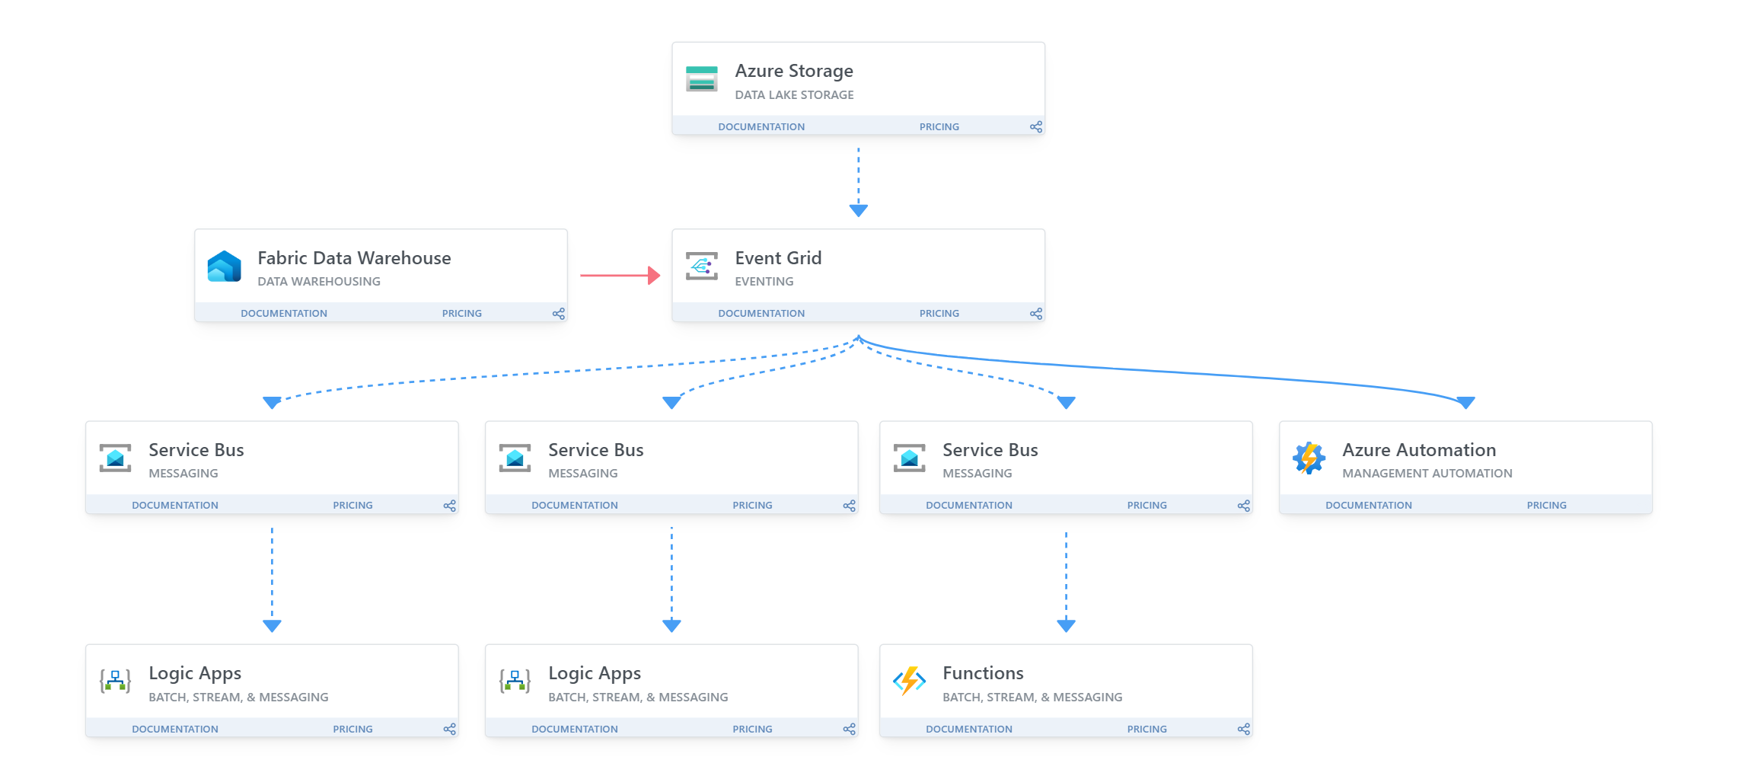
What to achieve?

Slide 8
What are we doing?
Understand Azure Event Grid
Custom Python libraries to interact with Event Grid
Integration of libraries in our workspaces
Azure Service Bus as throttler and coordinator
Reap the benefits
Filtering based on topic, eventType, and/or subject
Az Functions/Logic Apps/<Your invention>
Notes:
Understand Event Grid
Azure Event Grid acts as the central nervous system, orchestrating seamless communication between various components. It empowers us to create a responsive and dynamic data processing pipeline, allowing events to flow effortlessly, triggering actions and insights in real-time. Understanding its capabilities is key to unlocking a new realm of event-driven architecture. So, we will delve into event grid key features to open a wide range of features for orchestration etc.
Custom Pyhton libraries:
To bridge the gap between our workspaces and Azure Event Grid, we develop custom Python libraries. These libraries encapsulate the logic needed to effortlessly interact with Event Grid. By leveraging these custom libraries, we simplify the integration process and empower our workspaces to communicate seamlessly with the Azure Event Grid infrastructure. We will explore the functionalities and ease of use that these libraries bring to our data processing mechanisms.
Integrating libraries in our workspaces:
Now that we have our custom Python libraries at our disposal, the next step is integrating them into our workspaces. This integration paves the way for a harmonious connection between our data processing environments and Azure Event Grid. We will navigate the steps to seamlessly incorporate these libraries, enabling our workspaces to become active participants in the event-driven paradigm we're creating.
Azure Service Bus:
Enter Azure Service Bus, our reliable throttler and coordinator in this event-driven setup. Acting as a crucial intermediary, Azure Service Bus ensures the smooth flow of events from Azure Event Grid to our subscribers. It provides throttling capabilities, coordinating the pace of event consumption. Discover how Azure Service Bus adds resilience and efficiency to our architecture, enabling a controlled and reliable flow of data (events).
Az Functions etc:
Azure Functions take center stage as versatile contributors to our orchestration. These functions wield the power to swiftly respond to specific data triggers, executing precise actions within our workflow. Serving as nimble components in our data processing framework, Azure Functions introduce agility and efficiency into the equation. Alongside them, Logic Apps and your innovative solutions further enhance our technical repertoire, collectively shaping a responsive and streamlined data processing landscape.
Filtering:
Efficiency lies in precision, and with Azure Event Grid, we have the ability to filter events based on specific criteria. Whether it's the topic, eventType, or subject, we can tailor the flow of events to meet our exact needs. We will explore the power of filtering in Azure Event Grid, allowing us to fine-tune the events that matter most to our data processing workflows and orchestration.
Reap the benefits
From streamlined workflows to real-time responsiveness, the integration of Azure Event Grid and our custom Python libraries transforms data processing into a seamless, automated symphony. By embracing these technologies, we empower our workspaces to become agile, efficient, and proactive in the face of dynamic data landscapes. Join us in reaping the benefits of this orchestrated data processing paradigm.

Slide 9
Azure Event Grid
Overview
Notes:
As we embark on our exploration of Azure Event Grid, let's delve into the foundational understanding of this powerful tool. Azure Event Grid serves as a dynamic eventing service that opens up a realm of possibilities in unifying and automating your data loading workflows.
At its core, Azure Event Grid enables seamless communication and notification between different components of your system, providing a reliable and scalable infrastructure. Think of it as the central nervous system of your data processing ecosystem, facilitating real-time interactions and responses to changes in the flow of data.
Key components of understanding Azure Event Grid include its ability to monitor changes in the layers of a data lake, trigger downstream processing tasks, handle logging, telemetry, and much more. Throughout this session, we'll unravel the layers of Azure Event Grid, exploring how its functionalities can be harnessed to enhance the efficiency and automation of your data processing pipeline.
So, let's embark on this journey of comprehension, where we'll demystify the core concepts of Azure Event Grid and lay the groundwork for a more streamlined and responsive data workflow.

Slide 10
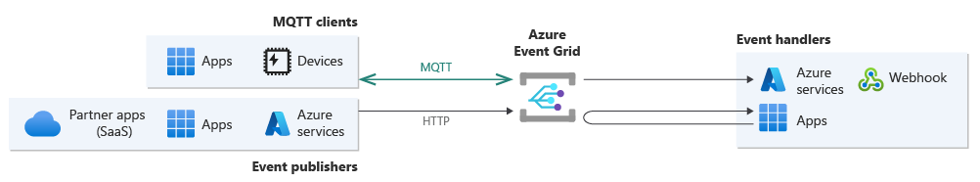
Key features: Publishers / Subscribers
Notes:
Blob Storage – Means every time a blob arrives, we can fire off an event, automatically

Slide 11
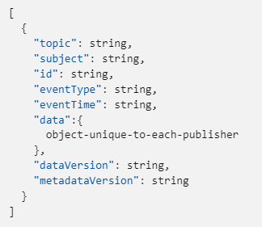
Key features: event schema

Slide 12
Key features: routing #1
Topic Filtering
System; All systems related events
Data; All data related events
Shipment; All event related to deployment: code, reports etc.
Event Type Filtering
production/status/notebook/init
test/telemetry/file/success
Subject Filtering
/blobServices/default/containers/<container>/blobs/<blob>
/silver/pos/sales/<customer>

Slide 13
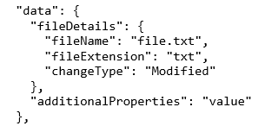
Key features: routing #2
Data Specific Filtering
data.fileDetails.fileExtension == “txt”

Slide 14
Key features: Dead lettering & Retry
Error Handling
Dead lettering; Events that cannot be delivered to any subscribers are sent to a dead-letter endpoint, helping to address and identify issues.
Resilience
Retry policies; Azure Event Grid employs automatic retry mechanisms to handle transient failures, ensuring that events are reliably delivered.

Slide 15
Summary: Event Grid
Publisher/Subscriber
eventSchema
Routing
Dead letter
Retry

Slide 16
Azure Service Bus (queue)
Overview
Notes:
Complementing the dynamic routing prowess of Azure Event Grid, Azure Service Bus Queues provide a robust foundation for reliable, ordered message processing. Messages are durably stored, ensuring that they are retained until successfully consumed, even in the face of transient failures. If message ordering is critical, Service Bus Queues support ordered message processing, guaranteeing that messages are processed in the sequence they arrive.
You can however bypass the last part by implementing sessions, which is an advanced technique in queuing where you can implement sort of a VIP queue system

Slide 17
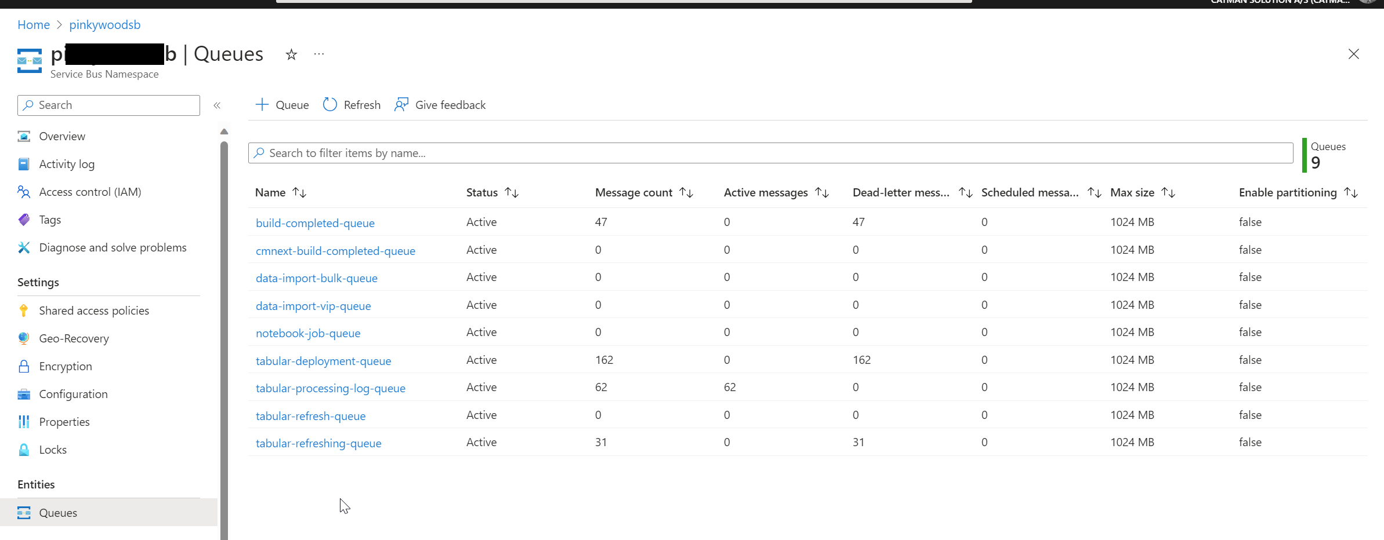
Azure Service Bus
Notes:
Complementing the dynamic routing prowess of Azure Event Grid, Azure Service Bus Queues provide a robust foundation for reliable, ordered message processing. Messages are durably stored, ensuring that they are retained until successfully consumed, even in the face of transient failures. If message ordering is critical, Service Bus Queues support ordered message processing, guaranteeing that messages are processed in the sequence they arrive.
You can however bypass the last part by implementing sessions, which is an advanced technique in queuing where you can implement sort of a VIP queue system

Slide 18
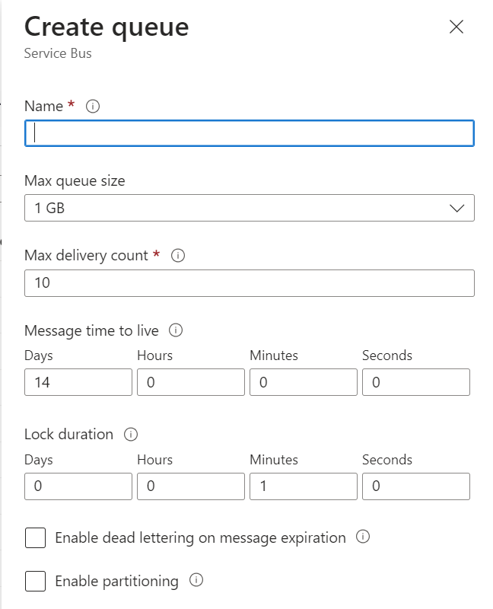
Configuring a new queue

Slide 19
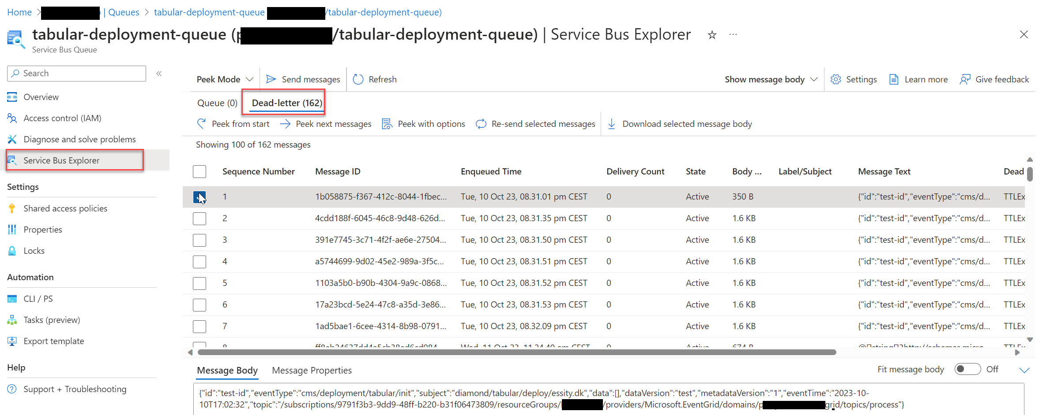
What’s in the queue?

Slide 20
Summary: Azure Service Bus
Create Queue(s)
Send message(s)
Keep track of message(s) and re-run

Slide 21
Custom Python
Overview
Notes:
As we embark on our exploration of Azure Event Grid, let's delve into the foundational understanding of this powerful tool. Azure Event Grid serves as a dynamic eventing service that opens up a realm of possibilities in unifying and automating your data loading workflows.
At its core, Azure Event Grid enables seamless communication and notification between different components of your system, providing a reliable and scalable infrastructure. Think of it as the central nervous system of your data processing ecosystem, facilitating real-time interactions and responses to changes in the flow of data.
Key components of understanding Azure Event Grid include its ability to monitor changes in the layers of a data lake, trigger downstream processing tasks, handle logging, telemetry, and much more. Throughout this session, we'll unravel the layers of Azure Event Grid, exploring how its functionalities can be harnessed to enhance the efficiency and automation of your data processing pipeline.
So, let's embark on this journey of comprehension, where we'll demystify the core concepts of Azure Event Grid and lay the groundwork for a more streamlined and responsive data workflow.

Slide 22
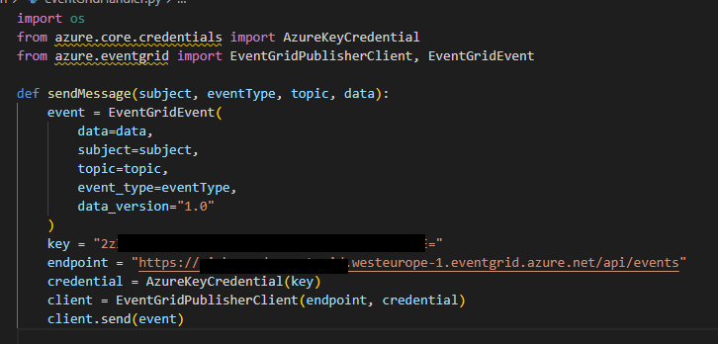
Custom Python function/method

Slide 23
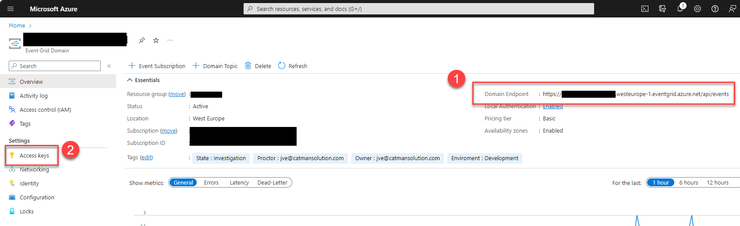
Getting Keys and Endpoint via Portal

Slide 24
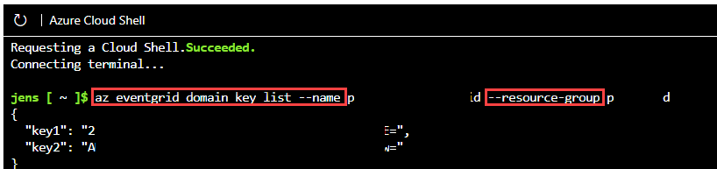
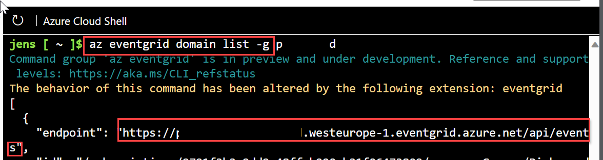
Getting Keys and Endpoint via CLI

Slide 25
Summary: Custom Python
Create function (VS Code)
Get Endpoint via Portal/CLI
Get Key via Portal/CLI

Slide 26
Workspace integration
Overview
Notes:
As we embark on our exploration of Azure Event Grid, let's delve into the foundational understanding of this powerful tool. Azure Event Grid serves as a dynamic eventing service that opens up a realm of possibilities in unifying and automating your data loading workflows.
At its core, Azure Event Grid enables seamless communication and notification between different components of your system, providing a reliable and scalable infrastructure. Think of it as the central nervous system of your data processing ecosystem, facilitating real-time interactions and responses to changes in the flow of data.
Key components of understanding Azure Event Grid include its ability to monitor changes in the layers of a data lake, trigger downstream processing tasks, handle logging, telemetry, and much more. Throughout this session, we'll unravel the layers of Azure Event Grid, exploring how its functionalities can be harnessed to enhance the efficiency and automation of your data processing pipeline.
So, let's embark on this journey of comprehension, where we'll demystify the core concepts of Azure Event Grid and lay the groundwork for a more streamlined and responsive data workflow.

Slide 27
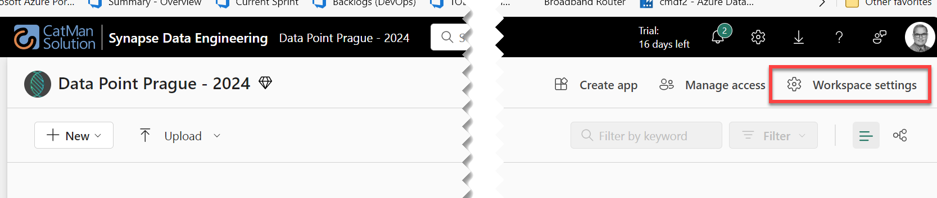
Setting up an Environment

Slide 28
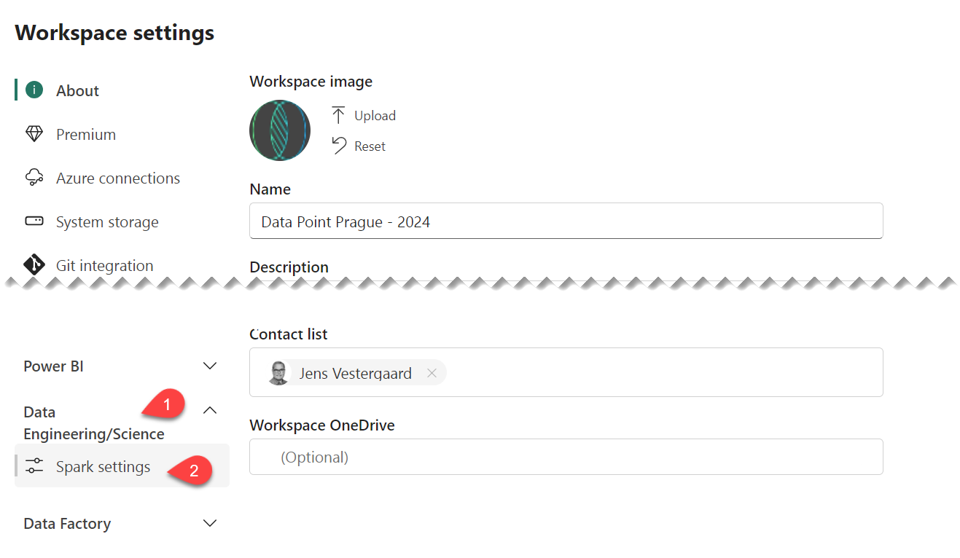
Setting up an Environment

Slide 29
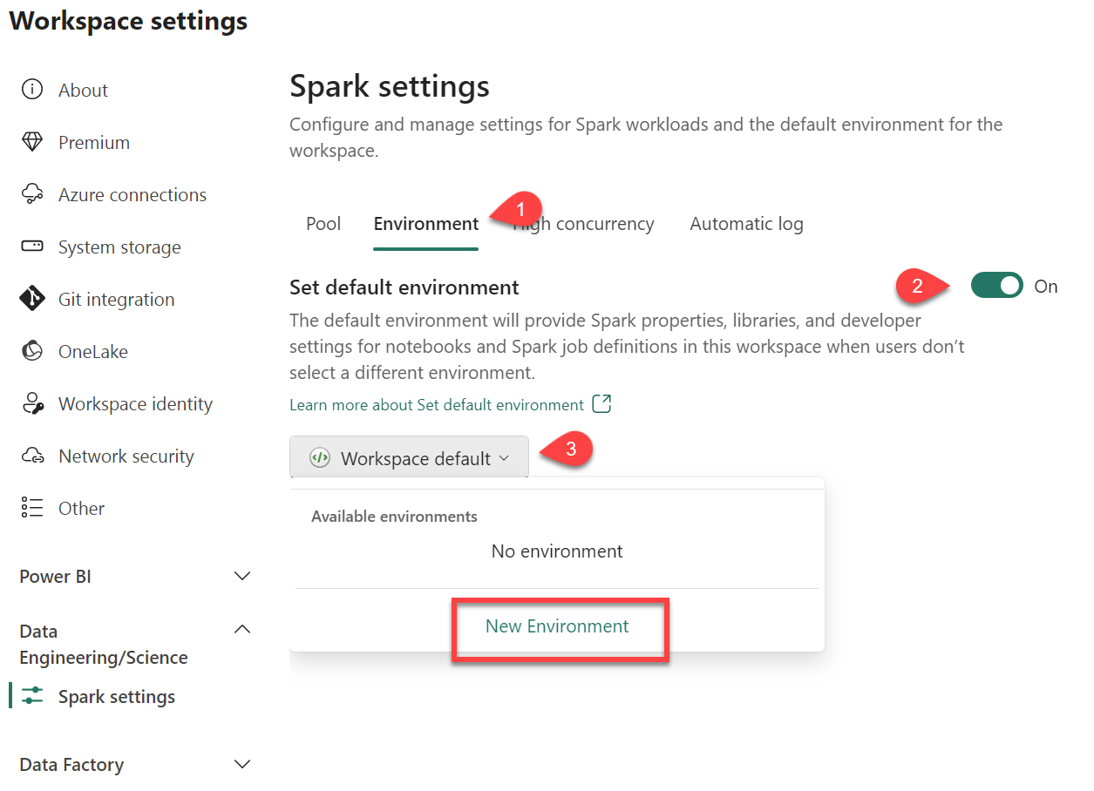
Setting up an Environment

Slide 30
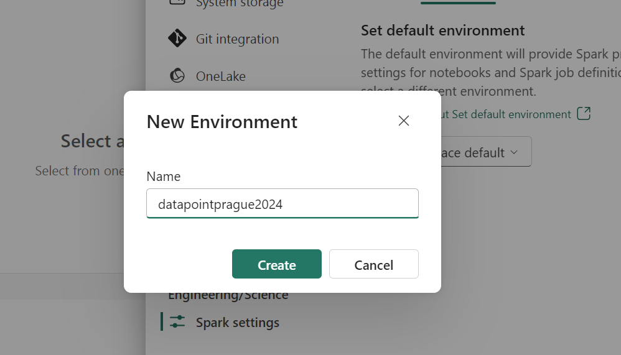
Name environment

Slide 31
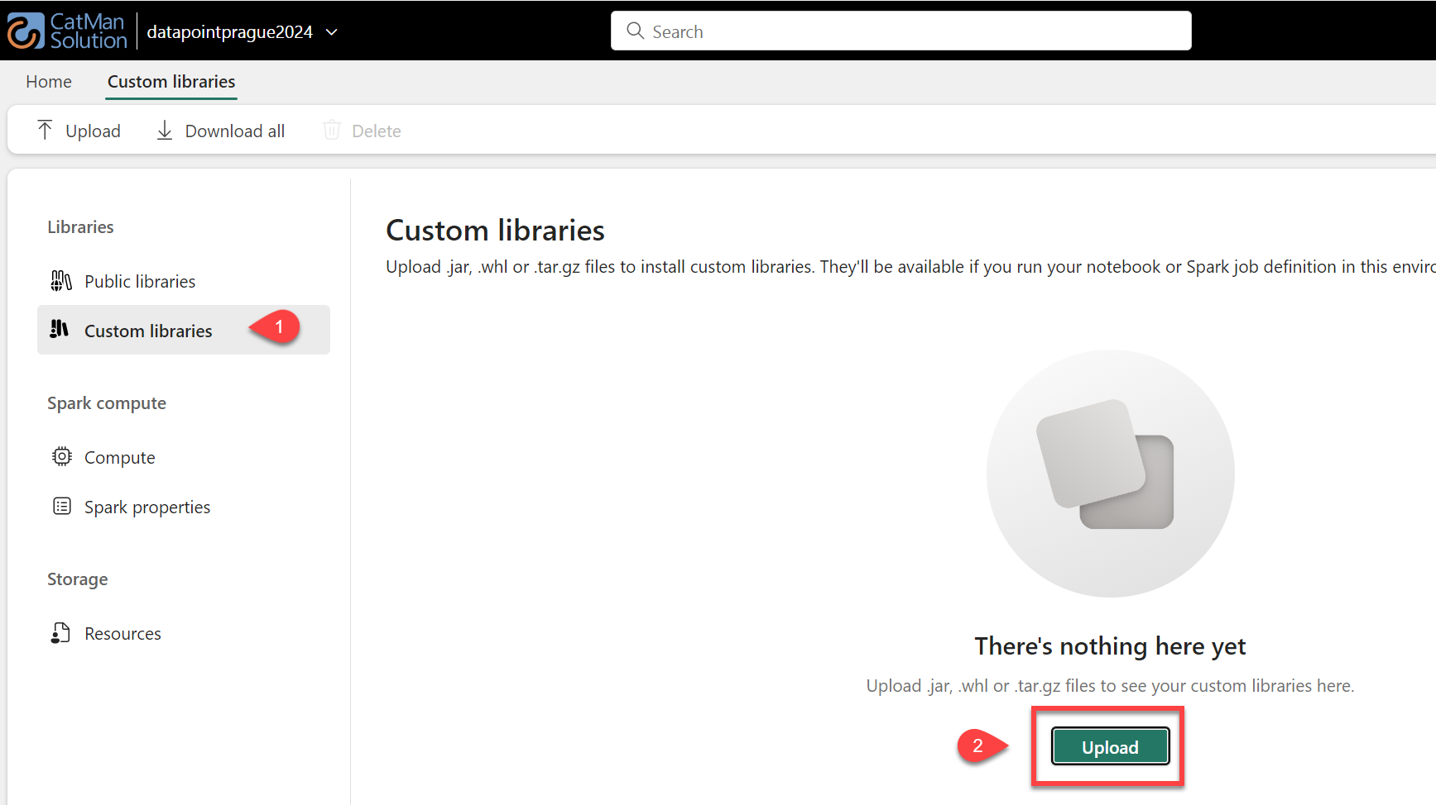
Setting up an Environment

Slide 32
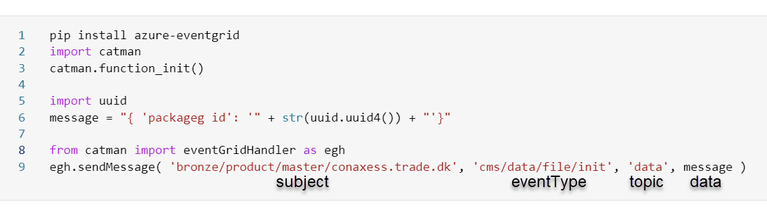
Send a message

Slide 33
Summary: Workspace integration
Create New Environment
Upload code (.whl)
Import code into notebook
Send message

Slide 34
Subscribing
Overview
Notes:
Complementing the dynamic routing prowess of Azure Event Grid, Azure Service Bus Queues provide a robust foundation for reliable, ordered message processing. Messages are durably stored, ensuring that they are retained until successfully consumed, even in the face of transient failures. If message ordering is critical, Service Bus Queues support ordered message processing, guaranteeing that messages are processed in the sequence they arrive.
You can however bypass the last part by implementing sessions, which is an advanced technique in queuing where you can implement sort of a VIP queue system

Slide 35
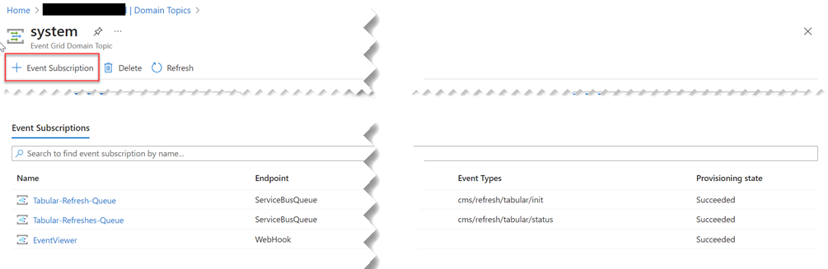
Subscribing to events

Slide 36
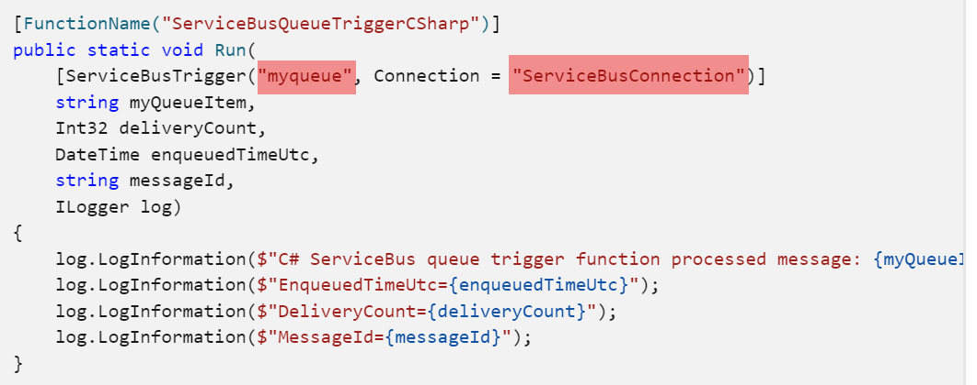
Binding Az Function

Slide 37
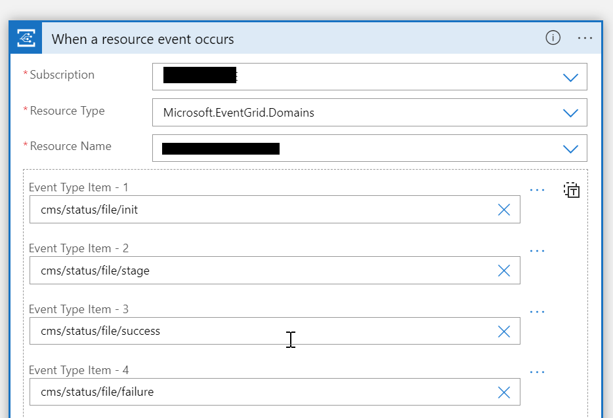
Logic Apps to the rescue

Slide 38
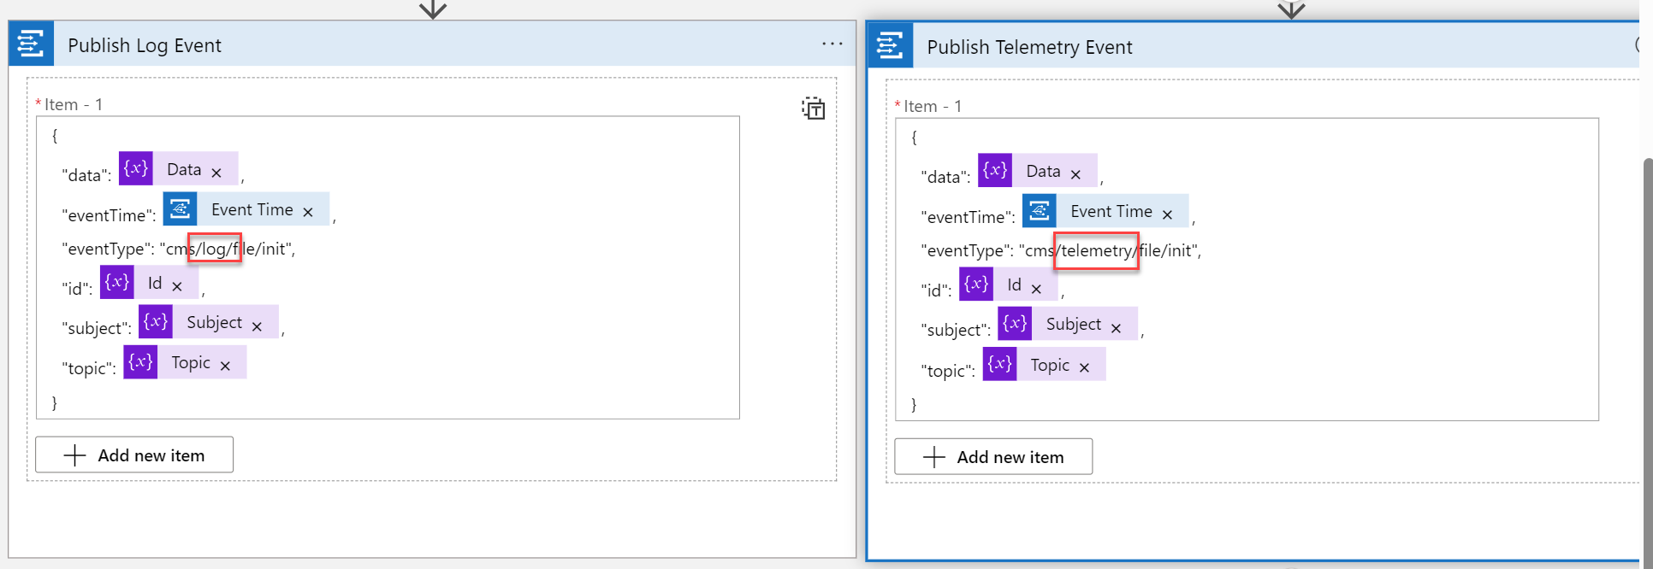
Logic App – Splitting Events

Slide 39
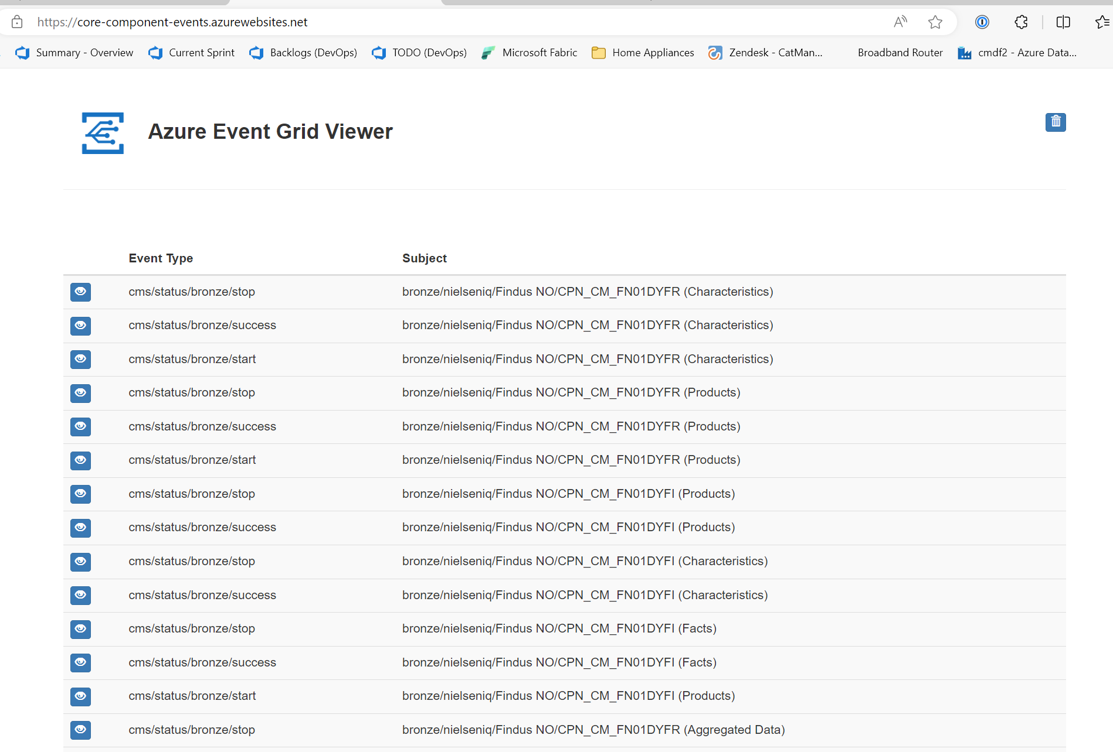
Azure Event Grid Viewer

Slide 40
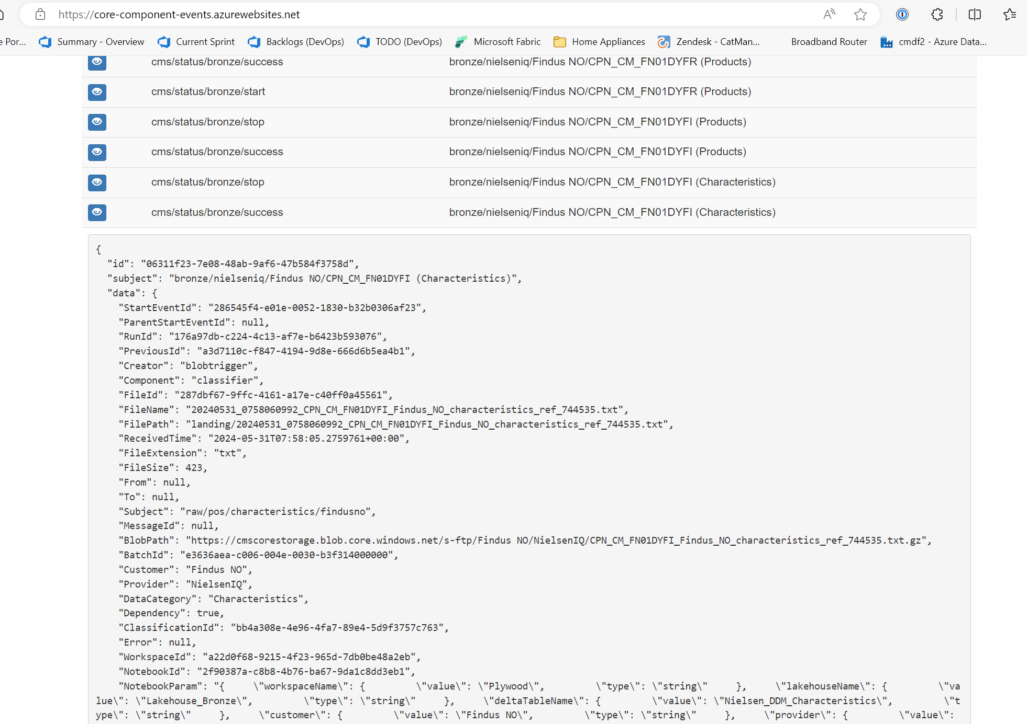
Azure Event Grid Viewer

Slide 41
Summary: Subscribing
Each topic can subscribe to + down stream services
Binding Azure Function Apps
Native support in Azure Logic Apps

Slide 42
Filtering
Overview
Notes:
Complementing the dynamic routing prowess of Azure Event Grid, Azure Service Bus Queues provide a robust foundation for reliable, ordered message processing. Messages are durably stored, ensuring that they are retained until successfully consumed, even in the face of transient failures. If message ordering is critical, Service Bus Queues support ordered message processing, guaranteeing that messages are processed in the sequence they arrive.
You can however bypass the last part by implementing sessions, which is an advanced technique in queuing where you can implement sort of a VIP queue system

Slide 43
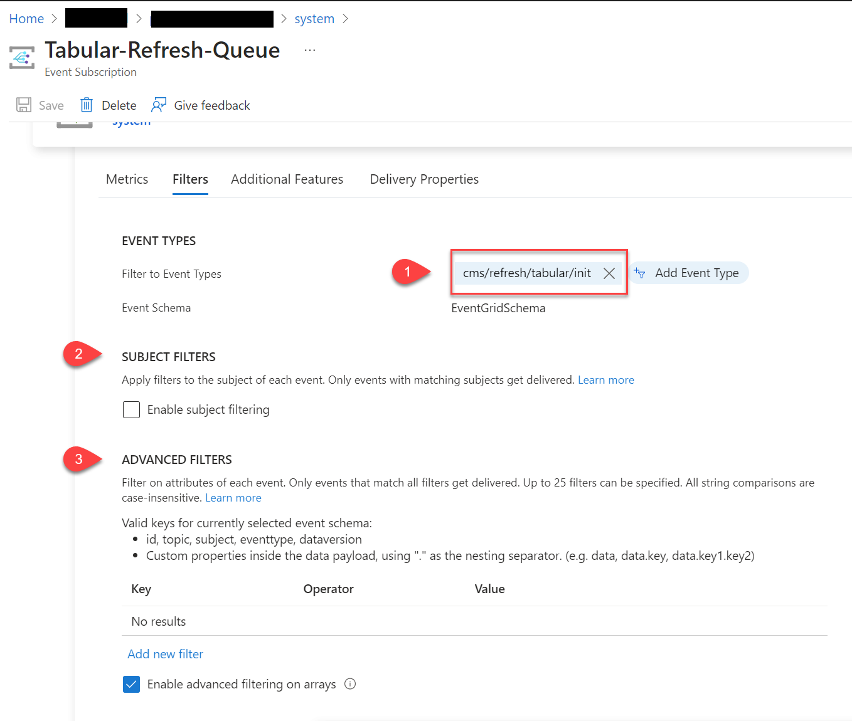
Filtering events

Slide 44
How are we doing so far?

Slide 45
Thank you
Connect to me at:
jv@t-sql.dk
@vestergaardj (X/Mastodon/Bluesky)

Slide 46
Resources to study more
Overview - Azure Event Grid | Microsoft Learn
https://learn.microsoft.com/en-us/azure/event-grid/overview GitHub - Azure-Samples/azure-event-grid-viewer: Live view of events from Azure Event Grid with ASP.NET Core and SignalR
Azure Service Bus Messaging documentation | Microsoft Learn
https://learn.microsoft.com/en-us/azure/service-bus-messaging/
How to use notebooks - Microsoft Fabric | Microsoft Learn
https://learn.microsoft.com/en-us/fabric/data-engineering/how-to-use-notebook
Overview - Azure Logic Apps | Microsoft Learn
https://learn.microsoft.com/en-us/azure/logic-apps/logic-apps-overview
Azure Functions Overview | Microsoft Learn
https://learn.microsoft.com/en-us/azure/azure-functions/functions-overview?pivots=programming-language-csharp

Slide 47


May 30 & 31 • 2024

Slide 48
Agenda and content slides

